Slide 1
DBMS Security
Kazi Amit Hasan

Slide 2
Next
March 13th >> Security (This one would be a descriptive class too. You can expect True/False question from this content)
March 16th >> Review class 1. I highly encourage you to attend this session, as I will highlight the most important topics and questions likely to appear on the final exam. Please use the Google Form or email me to let me know which topics you would like me to cover again. I plan to hold a couple of review classes before the final.
March 18th >> NoSQL. This class will be led by our graduate TA, Ashfi.

Slide 3
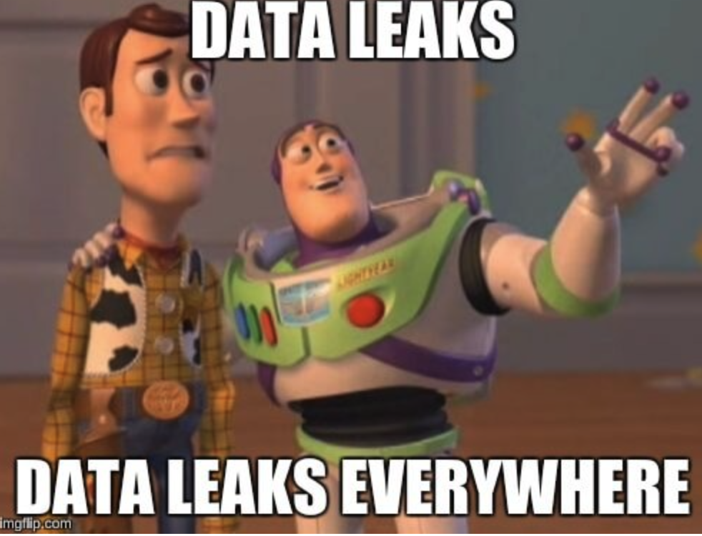
Data Breaches
More data = more database = more data breaches

Slide 4
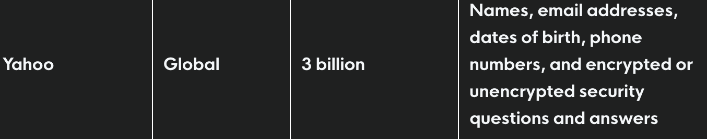

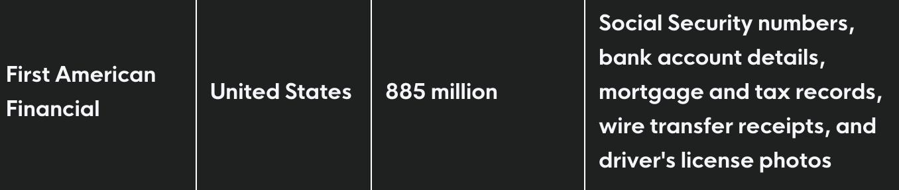
Data Breaches
Real incidents in last 10 years!

Slide 5
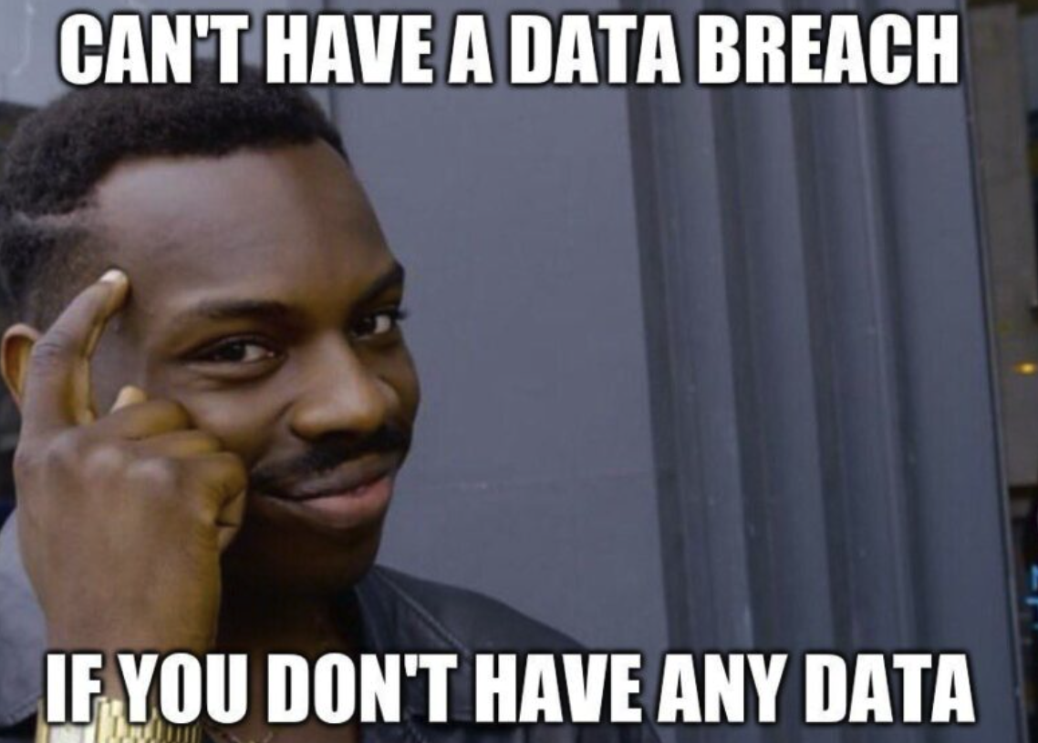
Data Breaches
Data is important and needs to be guarded
What are the consequences?
Reputation
Financial loss
Disruption
Identity theft
…….. Much more

Slide 6
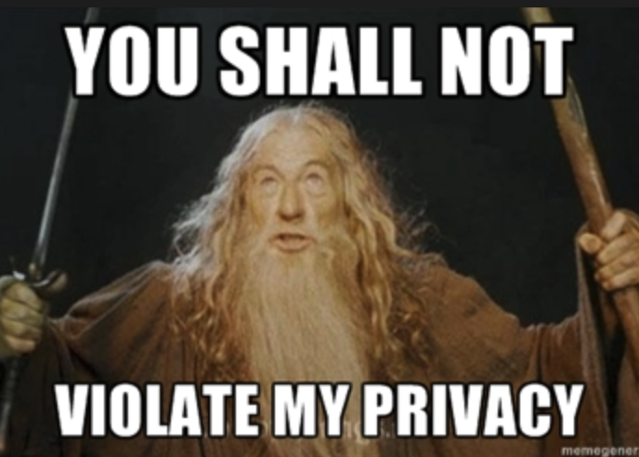
Privacy
Companies have an obligation to protect the privacy of individuals about whom they keep data.
Individuals have a right to privacy – some control over information about themselves.
Laws protect privacy and companies are obliged to follow these laws.
A hospital cannot simply give patient records to another company because it is convenient.

Slide 7
Threats to Databases
A database is secure only if the data stays correct, stays accessible to the right users, and stays hidden from the wrong users.
Loss of integrity
Integrity means accuracy of stored data
Data must be protected from improper modification
Loss of availability
Data objects must be available to users/programs that have a legitimate right to those objects
Could be caused by system overload or by someone maliciously deleting data
Loss of confidentiality
Data must be protected from unauthorized disclosure
Notes:
Suppose a hospital database stores patient records. A doctor needs to access a patient’s allergies before giving medicine.
But the database server crashes, or the system is overloaded, or ransomware locks the files.
The doctor cannot get the record in time.
That is a loss of availability.

Slide 8
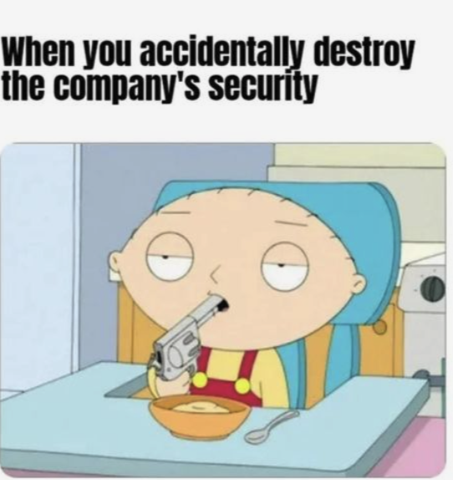
Accidental Security Threat Examples
user unintentionally requests an object or operation for which they are not authorized & the request is granted because of an oversite or error.
a person is accidentally sent a message meant for someone else resulting in unauthorized disclosure of database contents.
file system may accidentally write over files destroying parts of the database or fail to completely erase deleted files
Notes:
The key lesson is that database security is not only about stopping hackers. It is also about preventing human error, permission mistakes, software bugs, and storage problems.”

Slide 9
Intentional Security Threat Examples
wiretapping/sniffing to intercept data: means someone secretly listens to data while it is being sent over a network.
impersonating an authorized user by using their login credentials
Hacking - illegal code
deriving information about hidden data by clever querying of the database
SQL injections
Removing physical storage devices from site
Making copies of database
Bribing, blackmailing authorized users

Slide 10
Access control – DBA role
Controls must be defined to restrict access.
Database Administrator (DBA) is responsible for:
installing DBMS and configuring securely
creating account & giving each appropriate access
developing and enforcing standards for applications accessing this database
encrypting sensitive information (storage and transmission)
ensuring network connections are secure
establish audit mechanisms for the database
identify and guard against intruders

Slide 11
Authorization
DBMSs include an authorization subsystem that is responsible for ensuring the database against unauthorized access.
User assigned an DBMS specific account id an password
Access control mechanism to manage access to the data by the users

Slide 12
Database Authorization
We may assign a user several forms of authorizations on parts of the database.
READ: allows reading, but not modification of data
INSERT: Allows insertion of new data, but not modification of existing data
UPDATE: allows modification, but not deletion of data
DELETE: allows deletion of data
Each of these types of authorizations is called a privilege. We may authorize the user all, none, or a combination of these types of privileges on specified parts of a database, such as a relation or a view.

Slide 13
Authorization Specification in SQL
The grant statement is used to confer authorization
grant <privilege list> on <relation or view > to <user list>
<privilege list> This tells us what permission we are giving.
<user list> is:
one or more user-ids
public, which allows all valid users the privilege granted
Example:
grant select on department to Smith, Zhang
The grantor of the privilege must already hold the privilege on the specified item (or be the database administrator).

Slide 14
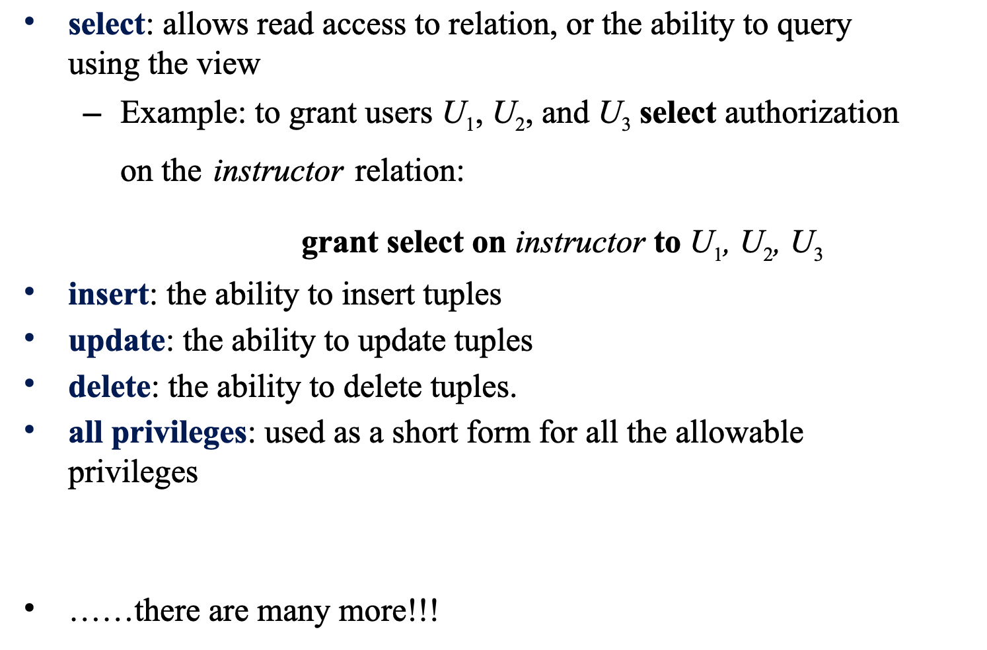
Privileges in SQL

Slide 15
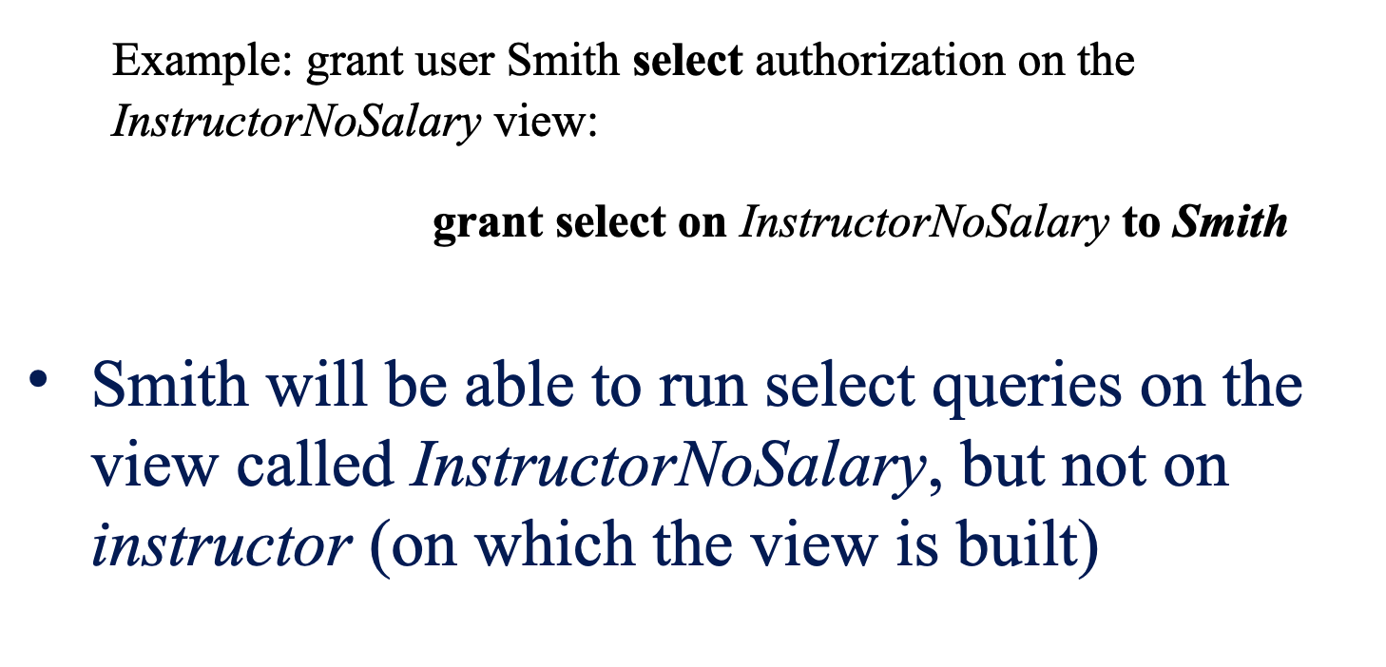
Privileges on a View

Slide 16
Revoking Authorization in SQL
The revoke statement is used to revoke authorization.
revoke <privilege list> on <relation or view> from <user list>
Example
revoke select on student from U1, U2, U3
This means instead of removing only one privilege, you can remove all privileges a user has on that object.

Slide 17
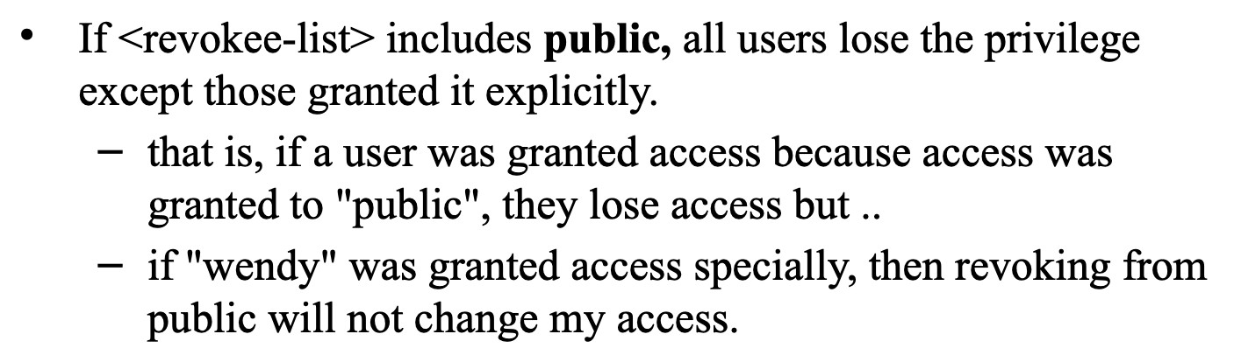
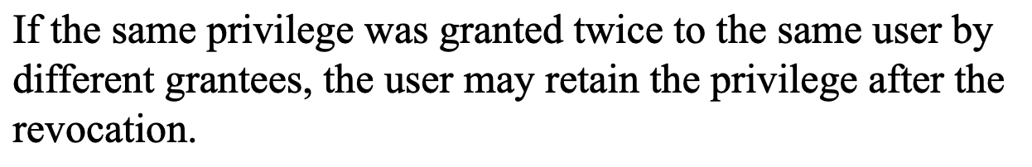
Revoking Authorization in SQL

Slide 18
Revoking Authorization in SQL
grant select on student to Wendy; -- by Alice
grant select on student to Wendy; -- by Bob
If Alice later says:
revoke select on student from Wendy;
Wendy may still keep SELECT access because Bob’s grant still exists.

Slide 19
Roles
A role is a way to distinguish among various users as far as what these users can access/update in the database.
To create a role we use: create role <name>
Ex: create role instructor
Once a role is created we can assign “users” to the role using:
grant <role> to <users>
Grant instructor to Kazi

Slide 20
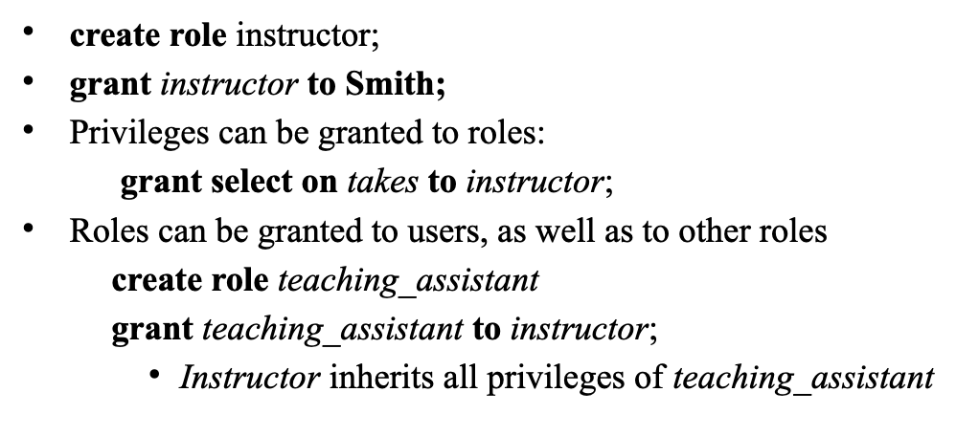
Roles Example

Slide 21
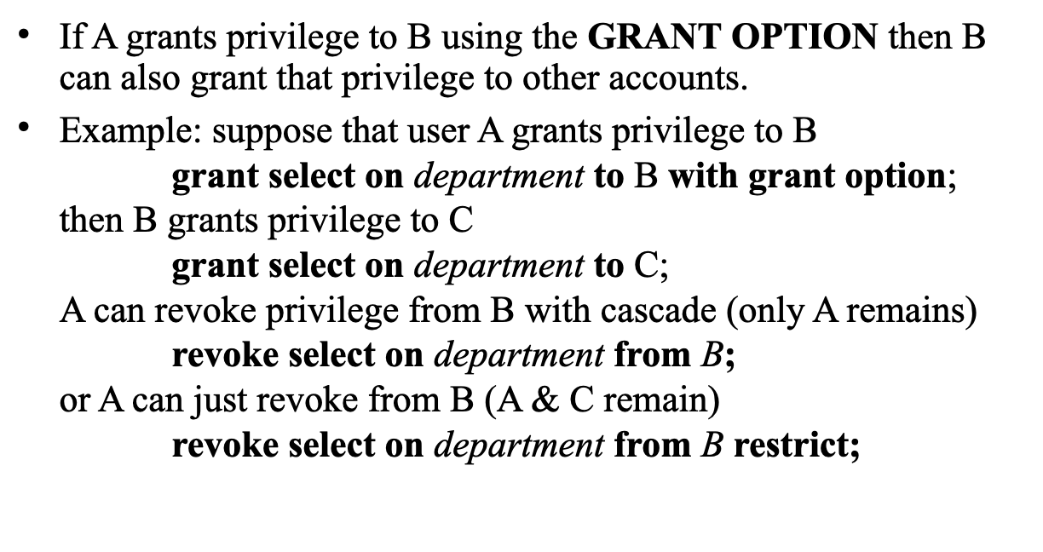
Propagation of Privileges

Slide 22
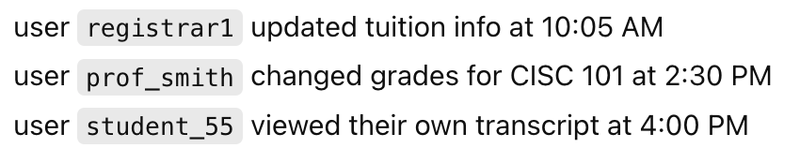
Security Logs and Audit Trails
security log – keeps a record of all (potential) attempted security violations.
Repeated passwords
Failed log in attempts etc
audit trail – records all accesses to the database including user information, the operation performed, the time, where it came from etc
this can be done using triggers
some DBMSs have it built-in (mysql has a plug in)

Slide 23
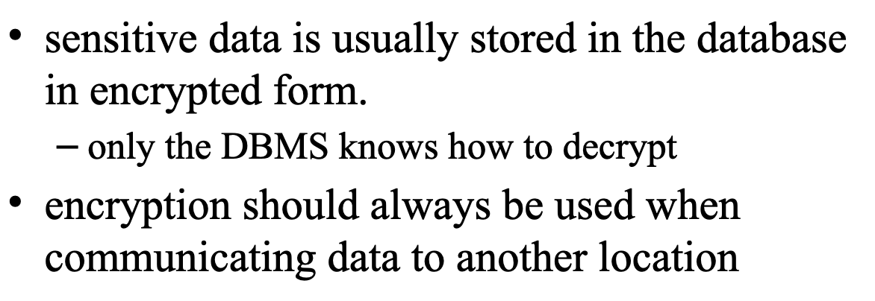
Encryption

Slide 24
Password Leaks (con't)
When writing applications (eg php code) – do not use "root" access as we did – instead, use a user with restricted privileges (only enough to get the job done)
Store the login/password in a configuration file instead of in the php file.
as a DBA, please remember to change the default root password for yourDBMS.

Slide 25
NEXT?
Review class 1. I highly encourage you to attend this session, as I will highlight the most important topics and questions likely to appear on the final exam. Please use the Google Form or email me to let me know which topics you would like me to cover again. I plan to hold a couple of review classes before the final.

